Slide 1
Chapter 3
Settling the North,
1619-1700

Slide 2
Protestant Reformation Produces Puritanism
Martin Luther’s 95 Theses (1517) divides Christianity
John Calvin (Calvinists):
Believed in predestination, God chose those that would be saved
Puritans:
Were Calvinists
Wanted to Purify the English (Anglican Church) of ALL Catholic rituals
Believed that only “Visible Saints” should be admitted to Church Membership
Separatists: Extreme Puritans who wanted to break away from Church of England all together
Harassed and want to leave England

Slide 3
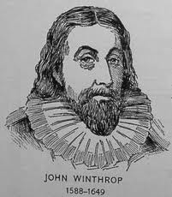
Massachusetts Bay Colony
Pilgrim leaders drew up and signed the Mayflower Compact- A simple agreement (not really a written constitution) to form a government and to submit to the will of the majority.
Promising step toward self- government because later adult male settlers assembled in town meetings.
John Winthrop-
Became colony’s first governor.
Declared that the purpose of the colony was to “be a city upon a hill” (COMMIT THIS TO MEMORY!!!)
The colonists believed that they had an agreement with God to build a holy society that would be a model for humankind.
Town Governments:
“Town Hall Meeting”: white, land-owning, male, church members

Slide 4
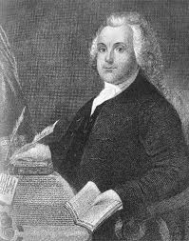
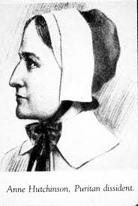
Religious Dissenters
Religious “Dissenters”
Anne Hutchinson
Known for challenging the authority of the clergy in the Bay Colony
Claimed to have direct contact with God
Challenged gender roles in the Church
Roger Williams
More threatening to Puritan leaders than Anne
Extreme Separatist, advocated for a clean break from the Anglican church (Church of England)
He also challenged Bay colony charter and condemned Bay for not paying Natives for their land
Denied the authority of government to regulate religious behavior
Banished to Rhode Island

Slide 5
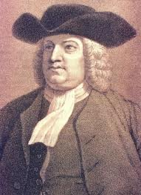
Various Colonies
RI:
Complete religious toleration to all
Roger Williams, Anne Hutchinson
NH:
Fishing and hunting
CT:
Fundamental Orders: written constitution that established democracy
PA:
William Penn (Quaker), religious toleration, pacifists, friendly to Native Americans, Women’s Rights

Slide 6
Religion in Colonies
Colonies that promoted religious toleration:
Rhode Island
Pennsylvania
Maryland (only to Christians)
Colonies that did NOT promote religious toleration
Massachusetts Bay
Toleration should only be extended to Puritans!
Most Tolerant

Slide 7
Conflicts with Native Americans
Pequot War and King Philip’s (Metacom) War
Both conflicts with natives over land
After King Philip’s war, Natives only posed a sporadic threat to New Englanders
New England Confederation (1643)
Formed by New England to make a defense against Natives, Dutch, French, etc.
Example of colonial unity!

Slide 8
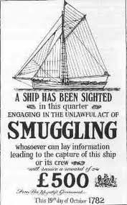
English Government Philosophy
Dominion of New England
Established to enforce Navigation Laws (colonies could only trade with England)
Colonies got around laws by……………
Salutary Neglect
England took a hands off approach with the colonies as long as they were making money
Ends in 1763!

Slide 9

That’s it!
Questions? Comments? Concerns? More explanation?
Email me (Mr. Cirbo).
Visit class wiki or APUSHReview.com
Spread the word!

